Slide 1
Comparing Data Scientist Salaries
Across Industries and Locations

Slide 2
Description
This research examines the average salaries of Data Scientists across different company sizes
We analyzed how these salaries vary based on the year of employment, experience level, and geographical location of employees.
Additionally, we incorporated data on the maximum and minimum salaries offered by companies, providing a comprehensive view of salary ranges within the industry. (Salary ranges are provided without consideration of company size)

Slide 3
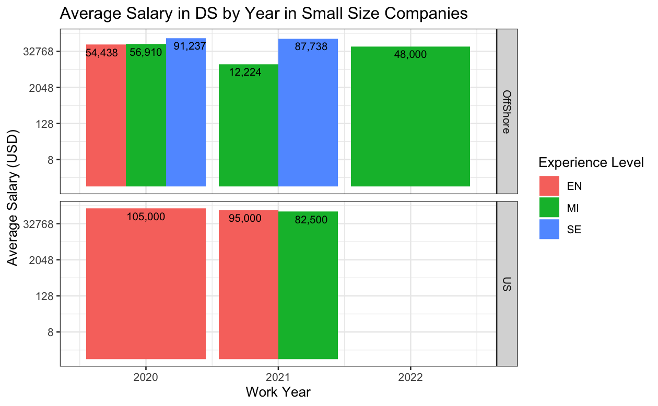
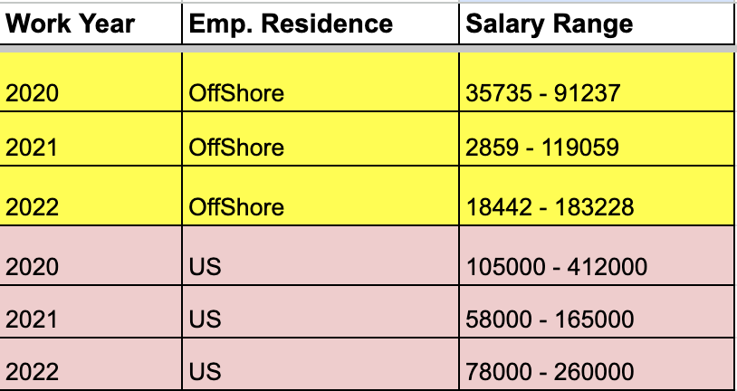
Graph of Average Salaries in Small-Sized Companies
Salary Range Table by Year and Residence (general salary range (S, M, L companies))

Slide 4
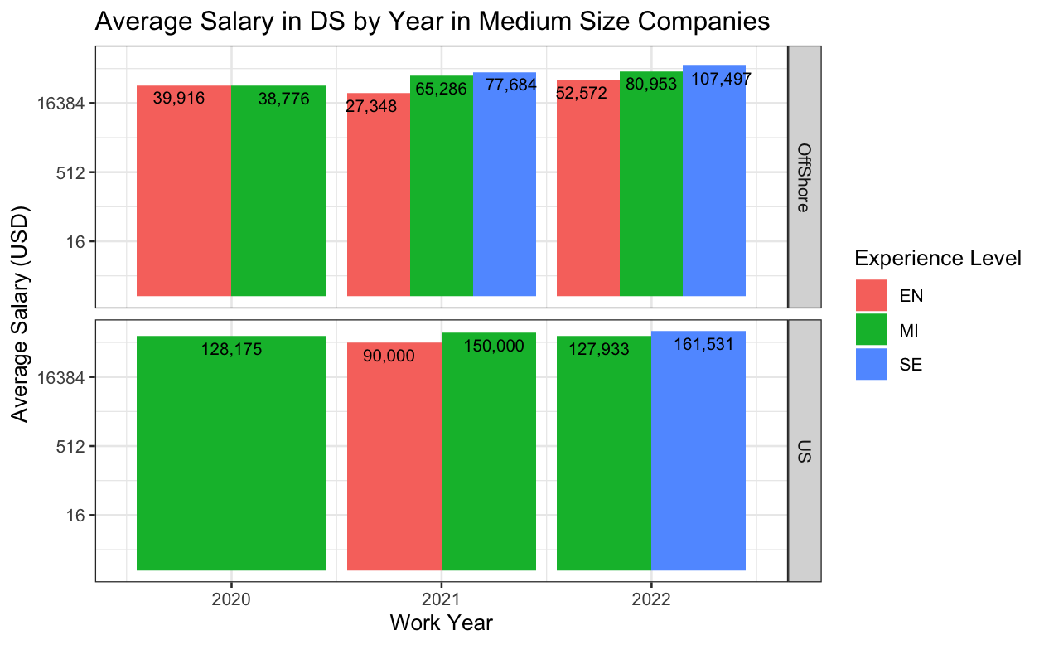
Graph of Average Salaries in Medium-Sized Companies
Salary Range Table by Work Year and Residence (General Salary Range (S, M, L companies))

Slide 5
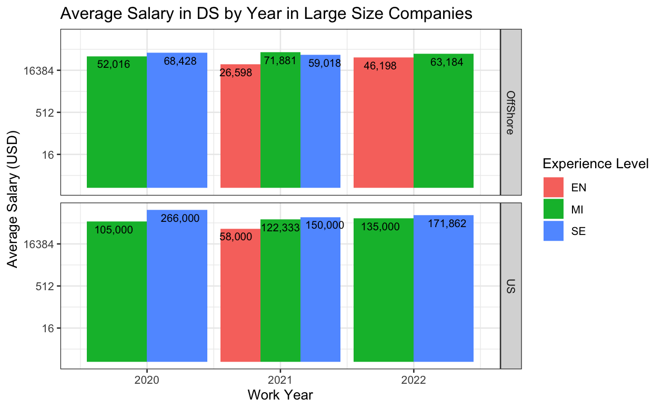
Graph of Average Salaries in Large-Sized Companies
Salary Range Table by Work Year and Residence (General Salary Range (S, M, L companies))

Slide 6
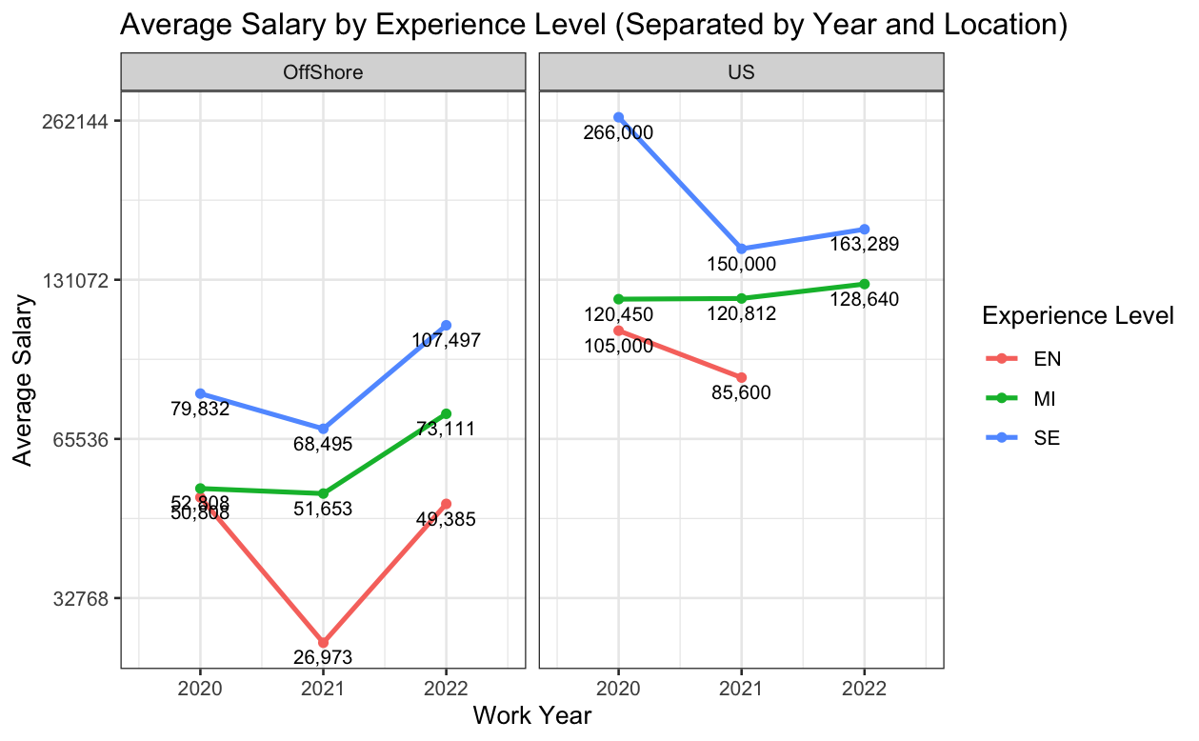
Line Graph of Average Salaries (mix of S, M and L companies)
This graph illustrates the fluctuations in average salaries over the years.

